Slide 1
EECS 2500 Linear Data Structures
Lecture 14
Chapter 06 – (General) Lists – Part 2
Fall 2016
Dr. Larry G. Thomas – University of Toledo/LCCC

Slide 2
Last Time
.equals(), .compareTo(), Comparable
Implementing ADTs “By Copy” or “By Reference”
There are advantages and drawbacks to both approaches.
Which one to use depends on the circumstance
ArrayUnsortedList Code on (pp. 399 – 403)
ArraySortedList Code on (pp. 404, 406 – 407)
ArrayIndexedClass Code on (pp. 411 – 414)
For each of these classes, you should be completely familiar with the code – STUDY IT!

Slide 3
Using Lists: Poker, Golf, & Music (§6.5)
You should be familiar with the code, how it works, and the examples for each of these applications.
The Poker application simulates 1,000,000 7-card stud poker hands, looking to see what the likelihood of a 7-card hand having one pair is
The Golf application uses the Comparable interface to create a list of players sorted by golf score
Note: The Comparable interface requires an Object parameter, so we have to explicitly cast it to Golfer
The Music application uses an indexed list to build a playlist of Songs that orders the songs as the user wishes, and keeps track of the total play time.

Slide 4
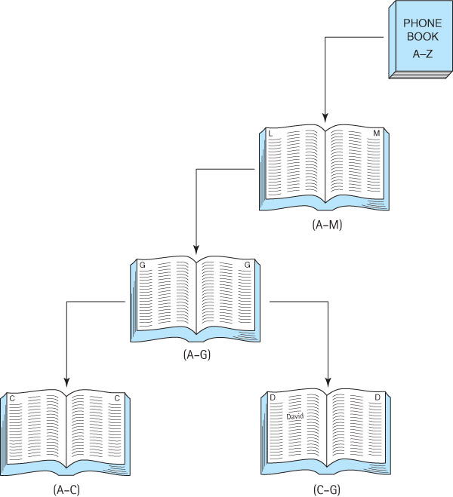
The Binary Search Algorithm (§6.6)
We covered this briefly in 1560, and again in Chapter 1 when we talked about algorithms and efficiency

Slide 5
Searching in a Phone Book
Suppose we are looking for “David” in a phone book
We open the phone book to the middle and see that the names there begin with M
M is “lexicographically larger than” (comes after) D
We can now limit our search to the section that contains A to M
We turn to the middle of the first half and see that the names there begin with G
G is larger than D
We can now limit our search to the section that contains A to G

Slide 6
Searching in a Phone Book (2)
We turn to the middle page of this section, and find that the names there begin with C
C is smaller than D
We can now limit our search to the section that contains C to G
And so on, until we are down to the single page that contains the name “David.”
Each iteration starts with a given range of candidate positions. We compare the target value against the value in the middle of the range for this iteration
Unless it happens to match the middle value, our target will be in either the first or second half for the next iteration

Slide 7
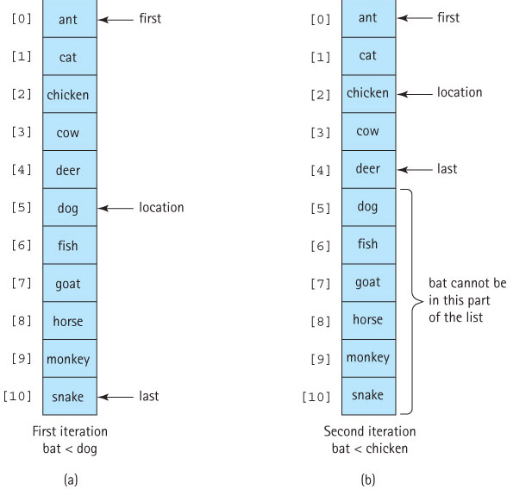
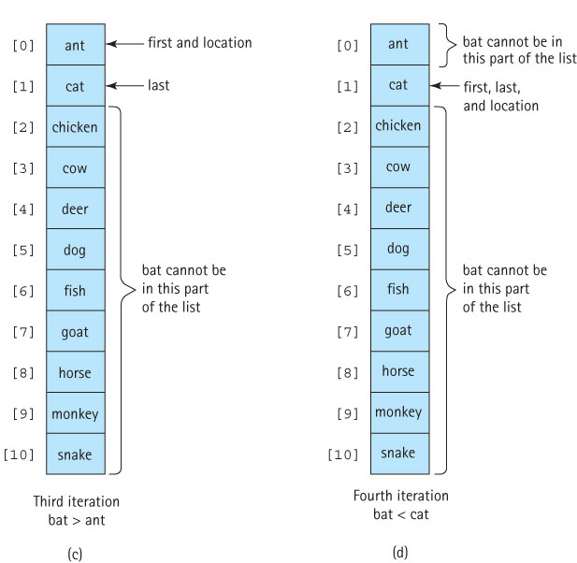
Searching for “bat” in a Sorted Array

Slide 8
The Revised find Method
protected void find(T target)
{
// if “target” is found, sets class-level variable found to true and location tells where
// if “target” is not found, sets found to false, and location is where the item WOULD be if on list
int first = 0; // We start by considering the WHOLE list,
int last = numElements - 1; // So first = 0, and last = numElements-1
int compareResult;
Comparable targetElement = (Comparable)target;
found = false;
while (first <= last)
{
location = (first + last) / 2; // Find the middle of the current section
compareResult = targetElement.compareTo(list[location]);
if (compareResult == 0) // target element is == element @ location
{
found = true;
break; // I prefer a return here
}
if (compareResult < 0) // target element is < element @ location
last = location - 1;
else // target element is > element @ location
first = location + 1;
}
}

Slide 9
Recursive Binary Search
Consider this informal description of the binary search algorithm:
To search a list, check the middle element on the list – if it's the target element, then you are done; if it's less than the target element, search the second half of the list; otherwise search the first half of the list.
There is something inherently recursive about this description:
We search the list by searching half the list.
The solution is expressed in smaller versions of the original problem: if the answer isn’t found in the middle position, perform a binary search (a recursive call) to search the appropriate half of the list (a smaller problem).

Slide 10
Recursive find Method
protected void recFind(Comparable target, int fromLocation, int toLocation)
{
if (fromLocation > toLocation) // Base case 1 – No more TO search!
found = false;
else
{
int compareResult;
location = (fromLocation + toLocation) / 2;
compareResult = target.compareTo(list[location]); // <0, ==0, or >0, depending
if (compareResult == 0) // Base case 2 – FOUND our target!
found = true;
else if (compareResult < 0) // target is < element at location
recFind (target, fromLocation, location - 1);
else // target is > element at location
recFind (target, location + 1, toLocation);
}
}
protected void find(Object target)
{
Comparable targetElement = (Comparable)target;
found = false;
recFind(targetElement, 0, numElements - 1);
}

Slide 11
Recursive find Method
protected void recFind(Comparable target, int fromLocation, int toLocation)
{
// check for recursive base case #1 – no more TO search:
if (fromLocation > toLocation) {found = false; return;}
// Otherwise, compare target against middle value and handle accordingly
location = (fromLocation + toLocation) / 2;
switch (Integer.signum(target.compareTo(list[location]))) // <0, ==0, or >0
{
// depending on the sign of the compareTo result, the value is found (0), in the first half (-1),
// or in the second half (+1)
case 0: found = true; break; // Base case 2 – FOUND our target!
case -1: recFind (target, fromLocation, location - 1); break; // is / should be in 1st half
case +1: recFind (target, location + 1, toLocation ); break; // is / should be in 2nd half
}
}
protected void find(Object target)
{
Comparable targetElement = (Comparable)target;
found = false; // not found yet!
recFind(targetElement, 0, numElements - 1); // kick off recursion on whole list
}

Slide 12
Efficiency Analysis
 | Maximum (worst-case) Iteration Count
Length | Linear Search | Binary Search
10 | 10 | 4
100 | 100 | 7
1,000 | 1,000 | 10
10,000 | 10,000 | 14
100,000 | 100,000 | 17
1,000,000 | 1,000,000 | 20
1,000,000,000 | 1,000,000,000 | 30

Slide 13
Reference-Based Implementation (§6.7)
In this section we develop list implementations using references (links).
We follow the same basic pattern of development here that we did when we developed list implementations using arrays.
Our reference-based implementations fulfill the interfaces we developed in Section 6.3.
We first implement an unsorted version, and then extend it with a sorted version

Slide 14

Reference-Based Lists
As we did for our reference-based stacks and queues, we use the LLNode class from the book’s support package to provide our nodes.
the information attribute of a node contains the list element
the link attribute contains a reference to the node holding the next list element
We maintain a variable, list, that references the first node on the list.

Slide 15
Reference-Based Lists
We'll implement both unsorted and sorted lists using the linked approach.
We do not implement indexed linked lists. There is no simple way to efficiently implement the add, set, get, and remove operations involving index arguments.
Indices map well to array subscripts – they don’t work for linked list nodes

Slide 16
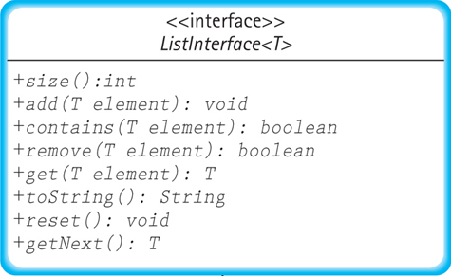
The RefUnsortedList Class
Implements the ListInterface
The size, toString, reset, and getNext methods are straightforward

Slide 17
The RefUnsortedList Class
Because the list is unsorted, and order of the elements is not important, we can just add new elements (nodes) to the front of the list (á la the Stack):
public void add(T element)
// Adds element to this list.
{
LLNode<T> newNode = new LLNode<T>(element); // make node
newNode.setLink(list); // new node -> old list
list = newNode; // List -> new node
numElements++; // Adjust element count
}

Slide 18
The find Method
protected void find(T target)
{
location = list;
found = false;
while (location != null)
{
if (location.getInfo().equals(target))
{
found = true;
return;
}
else
{
previous = location; // previous “lags behind” location
location = location.getLink();
}
}
}
// if target is located, found is set to true, and previous points
// to the target node’s predecessor; if not, found is set to false
Sets found to true / false and a variable named previous (which is used by the remove method) to where (if found)
Makes contains and get straightforward

Slide 19
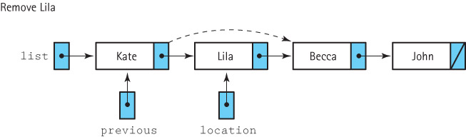
The remove Method
To remove an element, we first find it using the find method, which sets the location variable to indicate the target element and sets the previous variable to a reference in the previous node.
We can now change the link of the previous node to reference the node following the one being removed.
Removing the first node must be treated as a special case because the main reference to the list (list) must be changed.

Slide 20
The remove Method
public boolean remove (T element)
{
// Removes an element e from this list such that e.equals(element) and returns
// true (success); if no such element exists, returns false (failure).
find(element); // searches and sets found for us
if (found)
{
if (list == location) // If first node, remove
list = list.getLink();
else // remove node at location
previous.setLink(location.getLink());
numElements--; // the list now contains one fewer item
}
return found;
}

Slide 21
The RefSortedList Class
Implements the ListInterface
Extends the RefUnsortedList with an add method
Adding an element to a reference-based sorted list requires three steps:
Find the location where the new element belongs
Create a node for the new element
Correctly link the new node into the identified location

Slide 22
1. Find Where the New Element Belongs
To link the new node into the identified location, we also need a reference to the previous node.
While traversing the list during the search stage, each time we update the location variable, we first save its value in a prevLoc variable:
prevLoc = location;
location = location.getLink();
Particularly in 2510, we will have algorithms that are much easier to implement when we can conveniently refer directly to a node’s predecessor
Traversing with one reference “lagging” one node behind the other allows us to do so

Slide 23
2. Create a Node for the New Element
Instantiate a new LLNode object called newNode, passing its constructor the new element for use as the information attribute of the node:
LLNode<T> newNode = new LLNode<T>(element);

Slide 24
3. Correctly Link the New Node
We change the link in the newNode to reference the node indicated by location and change the link in our prevLoc node to reference the newNode:
newNode.setLink(location);
prevLoc.setLink(newNode);

Slide 25
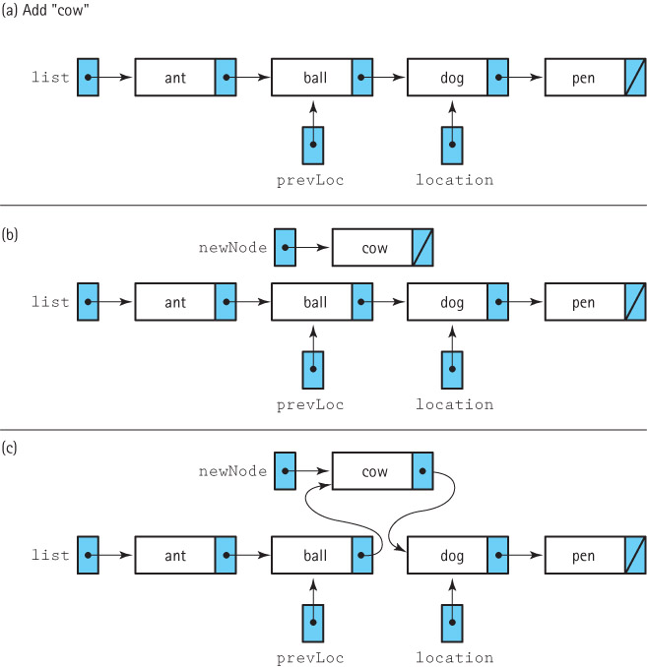
Add “Cow”
1
2

Slide 26
Special Case – First Node of List
What if location tells us we’re inserting before the first node in the list?
In this case we don’t have a previous node
We must change the main reference to the list (list)
if (prevLoc == null) // this node doesn’t HAVE a predecessor
{
newNode.setLink(list); // Insert as first node.
list = newNode;
}

Slide 27
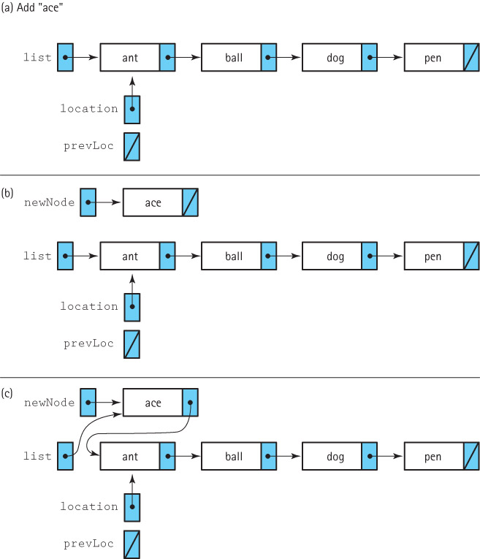
Special Case –Example: Add “ace”
1
2

Slide 28
The add method
The code for the add method is too long to fit on a slide.
It can be found on page 444 of the textbook.

Slide 29
Storing Objects in Files (§6.8)
Many programs need to save information between program runs
Alternatively, we may want one program to save information for later use by another program
In either case, the information is stored in files, which are the mechanism for permanently storing information on computers
In this subsection we investigate approaches for saving and retrieving objects and structures using files, including Java’s serialization facilities

Slide 30
Saving Object Data in Text Files
Any information we need to save can be represented by its primitive parts.
As a very simple example, consider a Song object, which has two instance variables:
protected String name; // title
protected int duration; // time in seconds
A song is not a “primitive” object, but when broken into its constituent parts, its information consists of a String and an int. Both of these can be saved as strings

Slide 31
Saving Object Data in Text Files
import java.io.*;
import support.*;
public class SaveSong
{
private static PrintWriter outFile;
public static void main(String[] args) throws IOException
{
Song song1 = new Song("Penny Lane", 177); // 2:57 = 177s
outFile = new PrintWriter(new FileWriter("song.txt"));
outFile.println(song1.getName()); // save song title
outFile.println(song1.getDuration()); // save song length
outFile.close();
}
}
Penny Lane
177

Slide 32
Reversing The Process
import java.io.*;
import java.util.*;
import support.*;
public class GetSong
{
public static void main(String[] args) throws IOException
{
String name;
int duration;
FileReader fin = new FileReader("song.txt");
Scanner songIn = new Scanner(fin);
name = songIn.nextLine(); // get song title from input file
duration = songIn.nextInt(); // get song length (duration) from input file
Song song2 = new Song(name, duration); // create a song object w/data
System.out.println("The name of the song is " + song2.getName());
System.out.println("The song’s length is " + song2.getDuration());
}
}

Slide 33
Serialization of Objects
Transforming objects into strings and back again is a lot of work for the programmer.
Imagine if our “object” was “student transcript”
Many semesters, courses, course names, grades
There could easily be a lot of pieces to handle
Fortunately, Java provides another way to save objects. This approach is called serializing the object.
Before seeing how to serialize objects, we must learn about a new interface and two support classes.

Slide 34
Support Constructs
We can write objects using the writeObject method of the ObjectOutputStream class.
To set up the output of serialized objects to the file objects.dat using the stream variable out, we write
ObjectOutputStream out = new ObjectOutputStream( new FileOutputStream("objects.dat"));
We can read objects using the readObject method of the ObjectInputStream class.
To set up reading from the same file, but this time using the variable in, we code
ObjectInputStream in = new ObjectInputStream( new FileInputStream("objects.dat"));

Slide 35
The Serializable interface
Any class whose objects we plan to serialize must implement the Serializable interface.
This interface has no methods!
This is known as a marker interface – it stamps whatever implements it with a particular attribute
It marks a class as potentially being serialized for I/O, so that the Java runtime engine knows to convert references as needed on output or input of class instances.
To make our objects serializable, we simply state that their class implements the interface.

Slide 36
Example
SerSong.java (page 448) is a version of our Song class that implements the Serializable interface
SaveSerSong.java (page 449) is an application that creates a SerSong object and saves it to a file
GetSerSong.java (page 449-50) is an application that retrieves that SerSong object and uses it.

Slide 37
Serializing Structures
The power of Java’s serialization tools really becomes evident when dealing with data structures
Because everything in Java is an object (except the primitives, of course, but they’re boxable), this behavior does not apply to C/C++
In C/C++, we have to read/write every item individually
There are benefits / drawbacks to both approaches

Slide 38
Serializing Structures
We can save or restore an entire array of SerSong objects with a single statement
To save the array:
SerSong[] songs = new SerSong[100];
...
out.writeObject(songs);
Once the array is saved, we can retrieve it later, perhaps from another program:
SerSong[] laterSongs = (SerSong[])in.readObject();

Slide 39
Serializing Structures
What is even more impressive is that Java’s serialization works for linked structures.
We can save an entire linked list using a single writeObject statement, and later restore it using a single readObject statement.
This approach works even for the non-linear reference-based structures covered in later chapters (but not this semester).
The tree and graph structures retain both their information and their structure using serialization.

Slide 40
Application: Song Lists (pp. 451 – 458)
For an example of serialization of a structure, we create an application that
allows us to enter song titles and lengths
displays song information
saves the song information
song indexes start at 1
if the user provides an illegal index for a song, instead of throwing an exception the program inserts the song at the end of the song list
the user can provide a name for the list of songs
Study this code, and run it for yourselves
Get the code from the publisher’s website

Slide 41
End of Chapter 6
? Questions ?

